Slide 1

OOP (Object-Oriented Programming)
Object-oriented programming is a programming paradigm based on the concept of objects.
Size
Color
Attributes
Airplane
Methods (Behaviours)
Fire()
Fly()

Slide 2
OOP (Object-Oriented Programming)
Blueprints
Class Airplane
Spitfire
Boeing

Slide 3
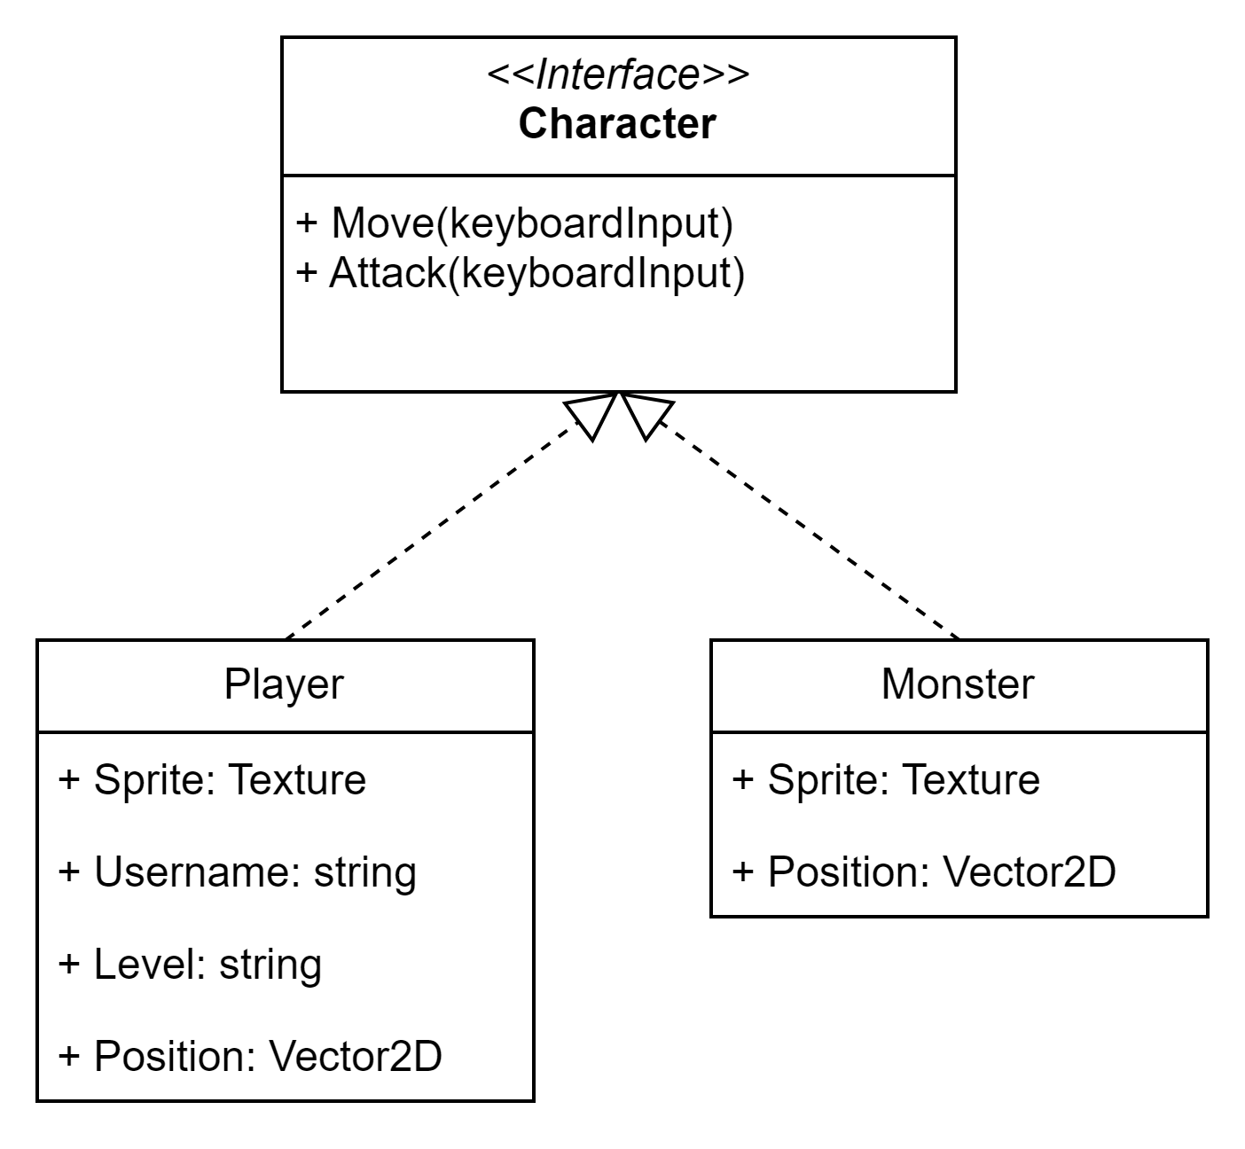
UML Diagrams Unified Modeling Language

Slide 4
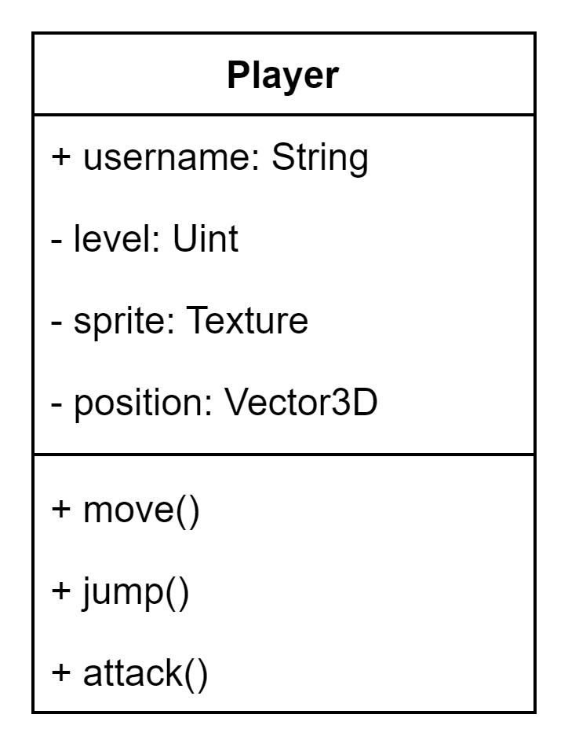
UML Basic
Class name
‘+’ is public
‘-’ is private
Field name: Datatype
Method

Slide 5
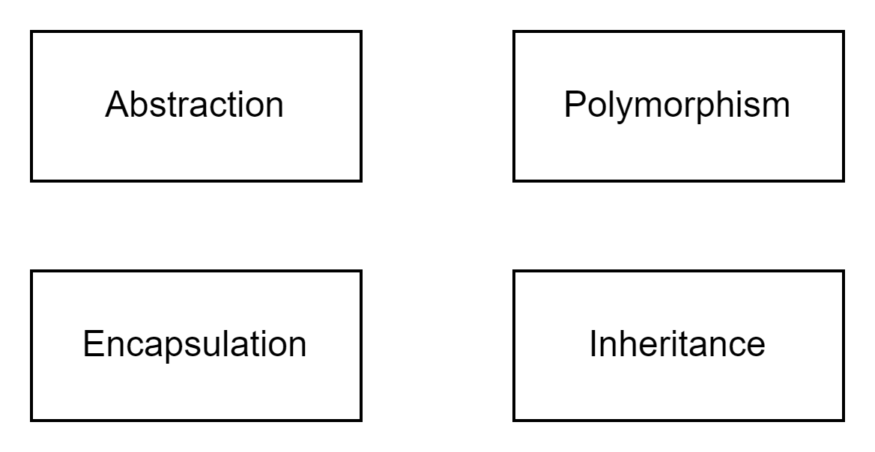
4 Pillars of oop

Slide 6
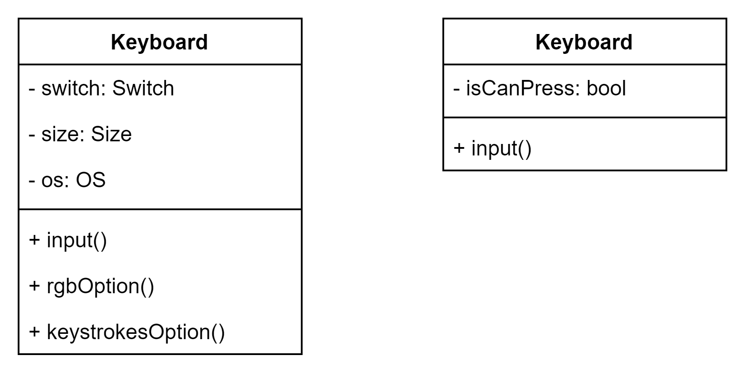
Abstraction
Same thing can be different in your mind.
Normal Keyboard
Mechanical Keyboard

Slide 7
Struct
Username: “Rayato159”
Level: 99
Status: ”Online” Class: “Magician”
Methods
move(…)
attack(…)
spell(…)

Slide 8
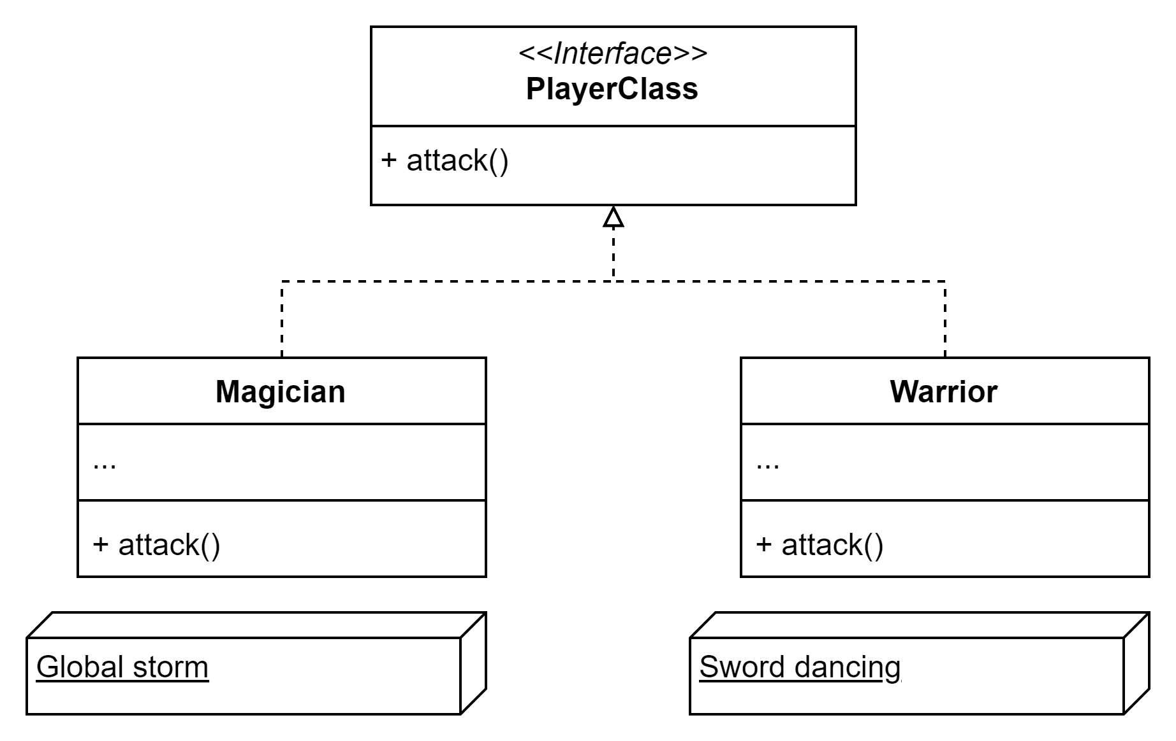
Polymorphism
As the concept of abstraction suggests, the same thing can be perceived differently in our minds. However, in this context, we have similar methods applied to different things.

Slide 9
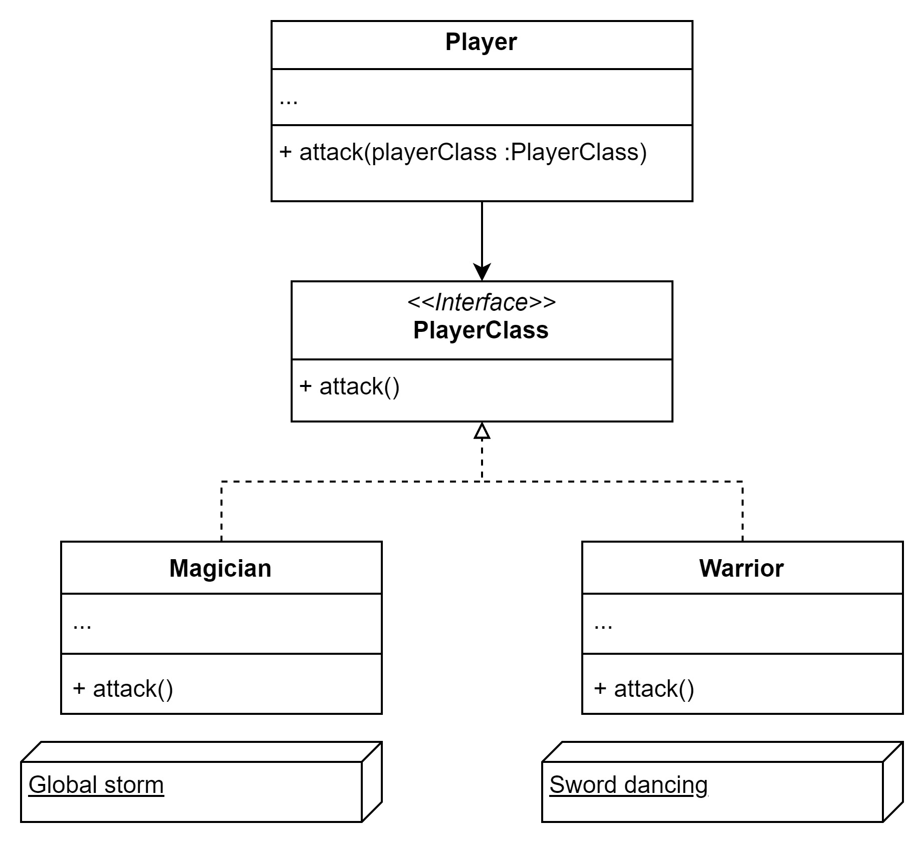
Encapsulation
The ability of an object to hide parts of its state and behaviors from other objects.

Slide 10
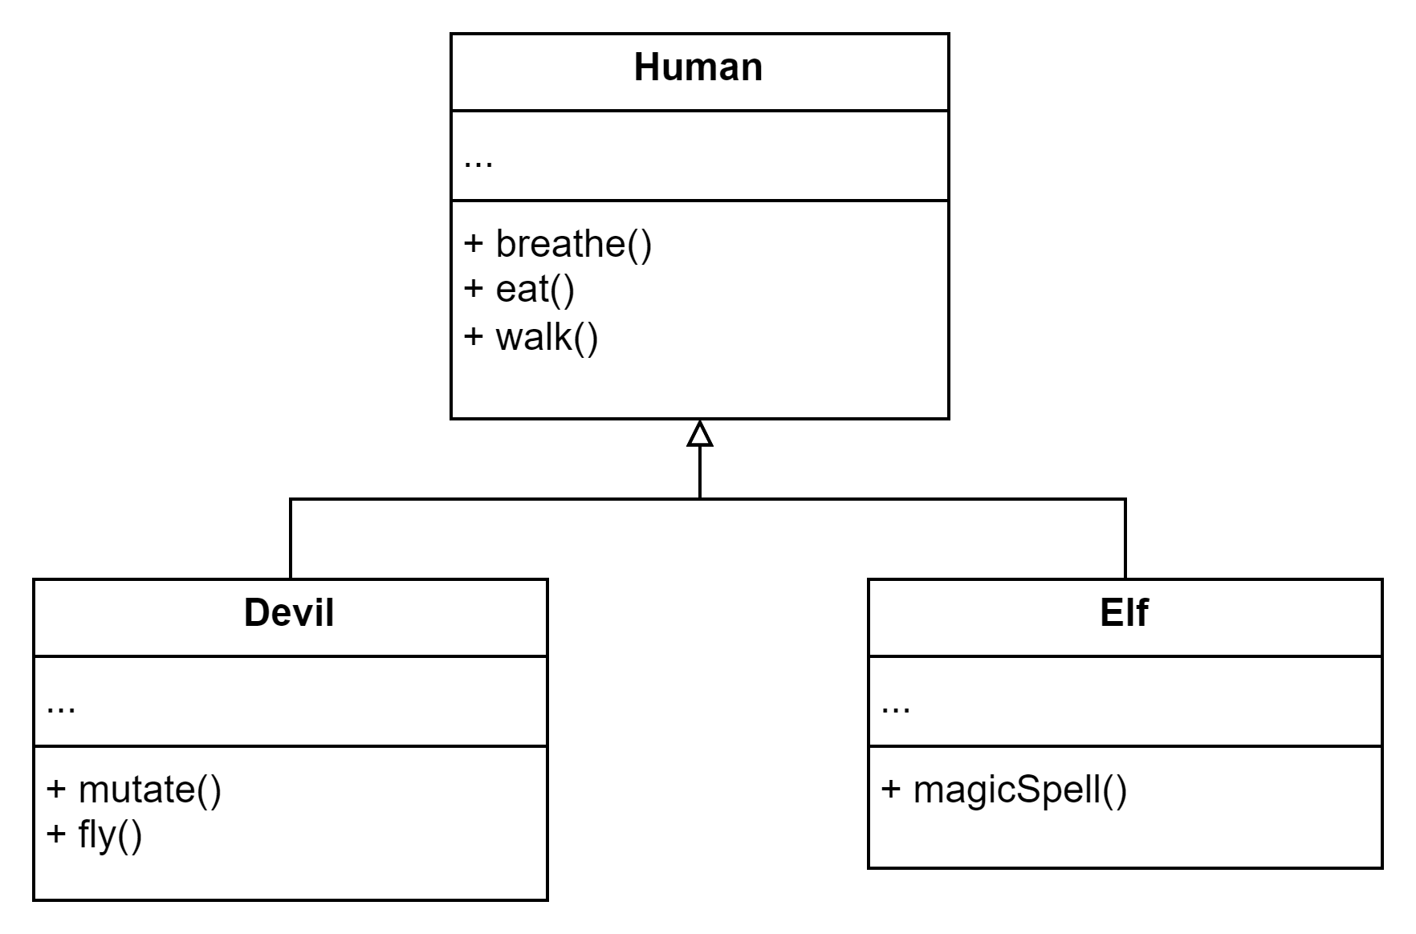
Inheritance
Inheritance is the ability to build new classes on top of existing ones. The main benefit of inheritance is code reuse.

Slide 11
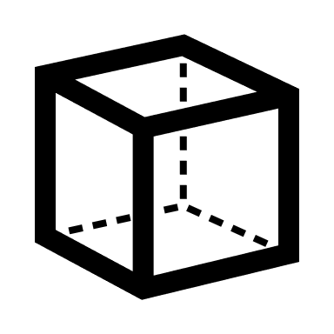

Relations Between Objects

Slide 12
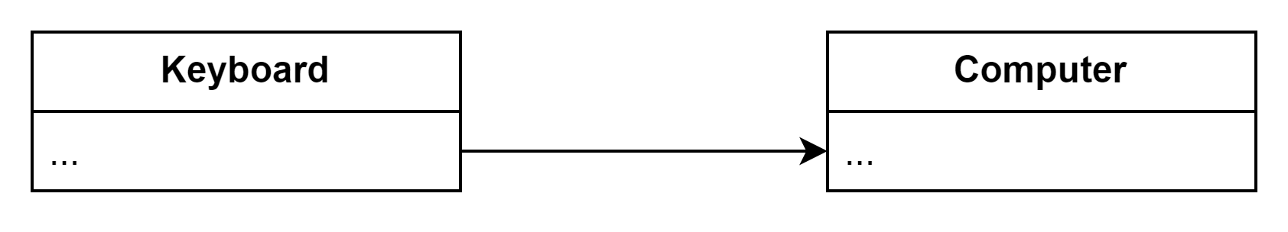
Association
Symbol
Computer has a keyboard.
Just to show that the computer has a relation with a keyboard.

Slide 13
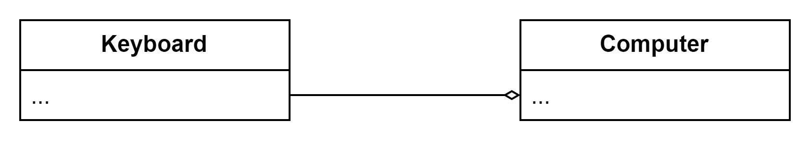
Aggregation
Symbol
Computer has a keyboard.
If the keyboard is missing the computer can still alive.

Slide 14
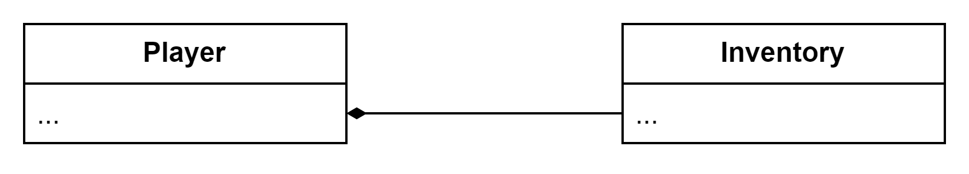
Composite
Symbol
Player has the inventory.
If a player is deleted, the inventory will cascade accordingly.

Slide 15
Inheritance
Symbol

Slide 16
Implementation
Symbol

Slide 17
SOLID Principles

Slide 18
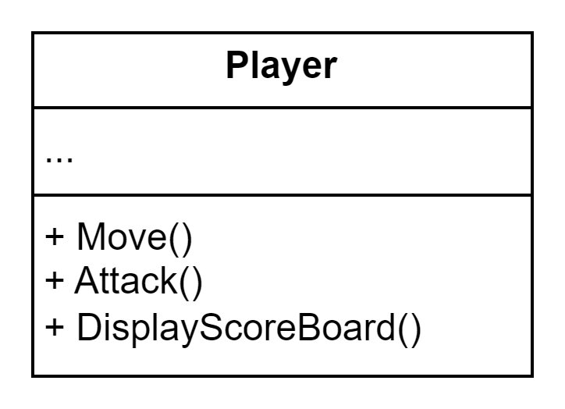
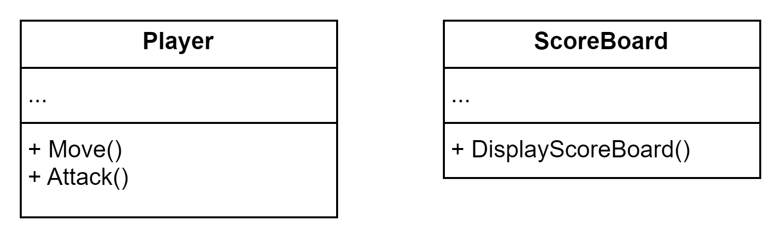


S — Single Responsibility Principle
A class should have just one reason to change.

Slide 19
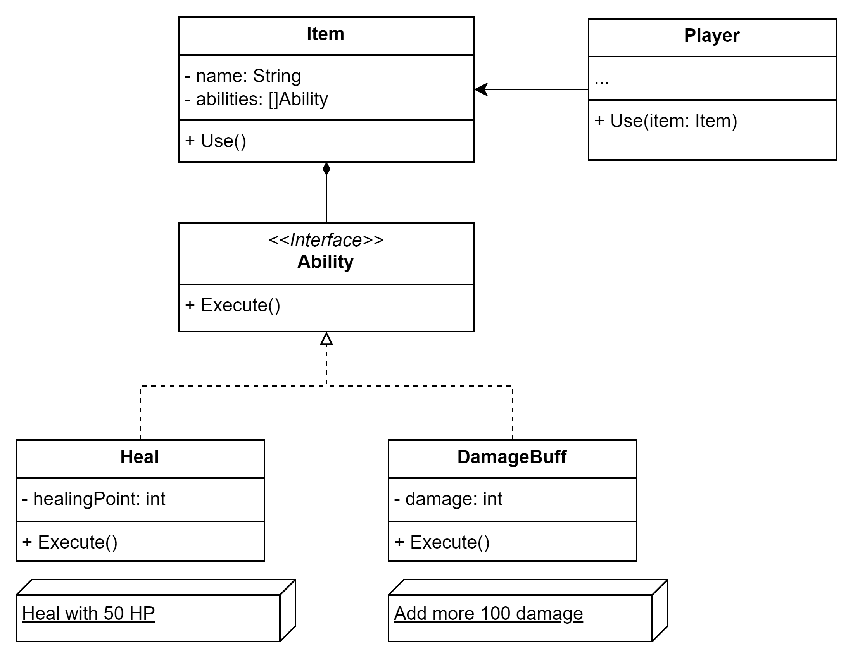
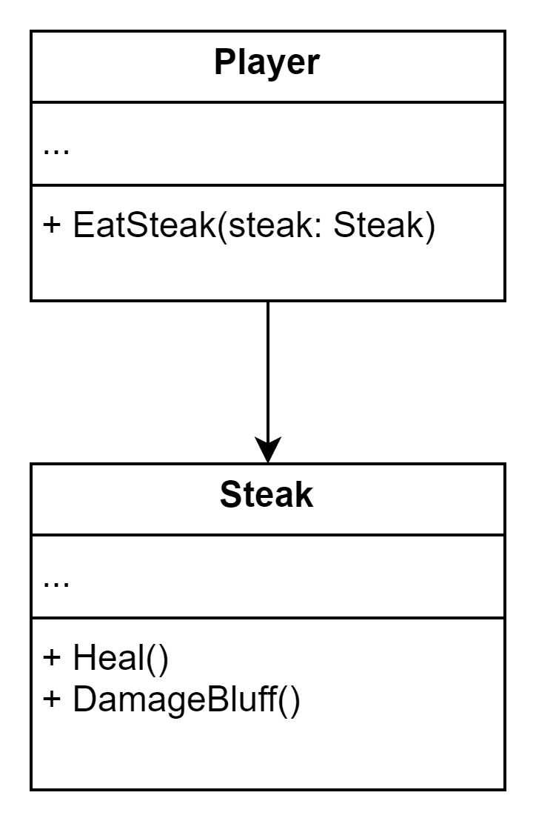
O — Open/Closed Principle
Classes should be open for extension but closed for modification.

Slide 20
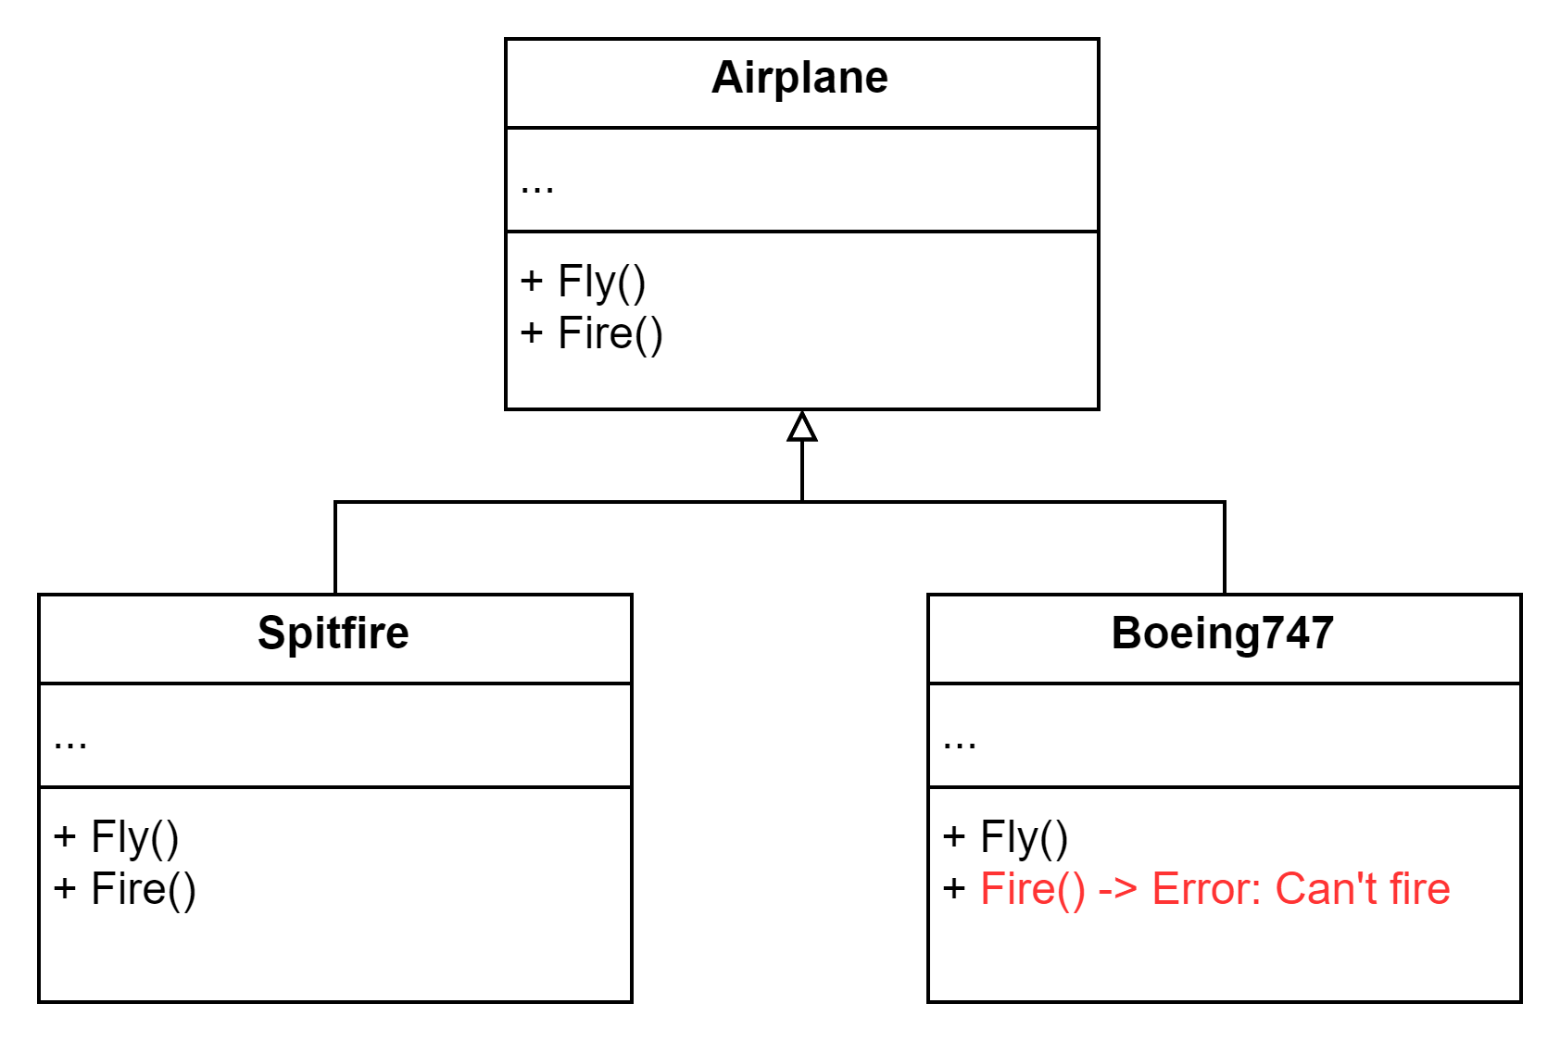
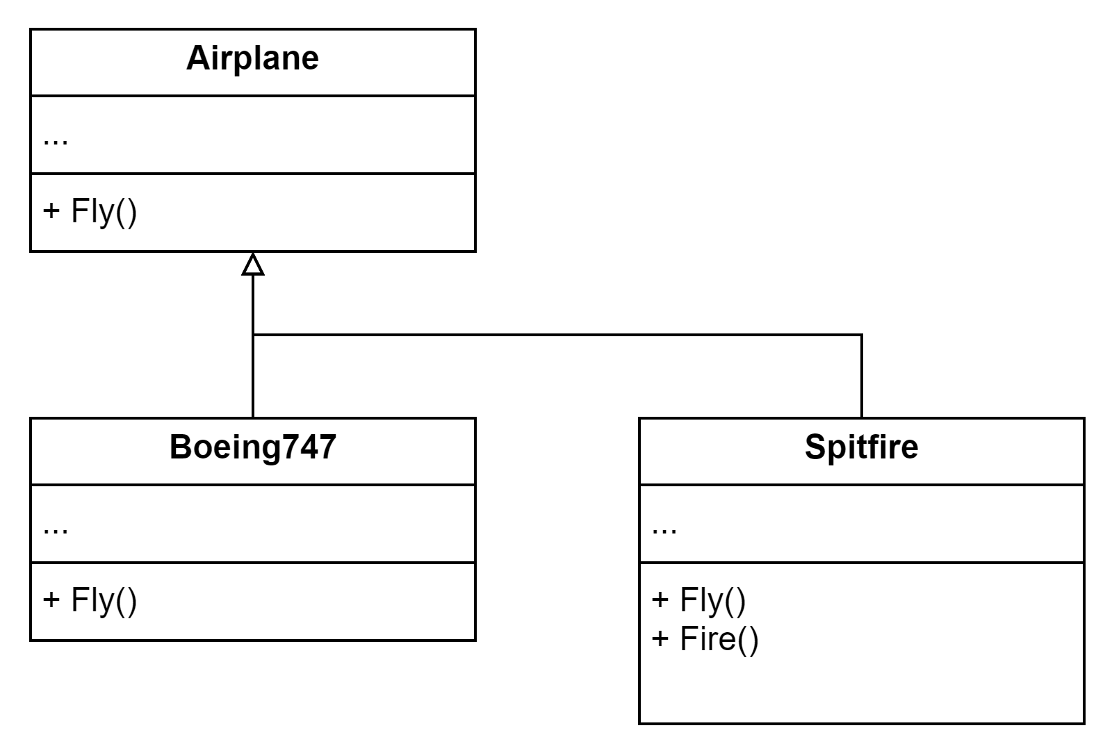
L — Liskov Substitution Principle (LSP)
When extending a class, remember that you should be able to pass objects of the subclass in place of objects of the parent class without breaking the client code.

Slide 21
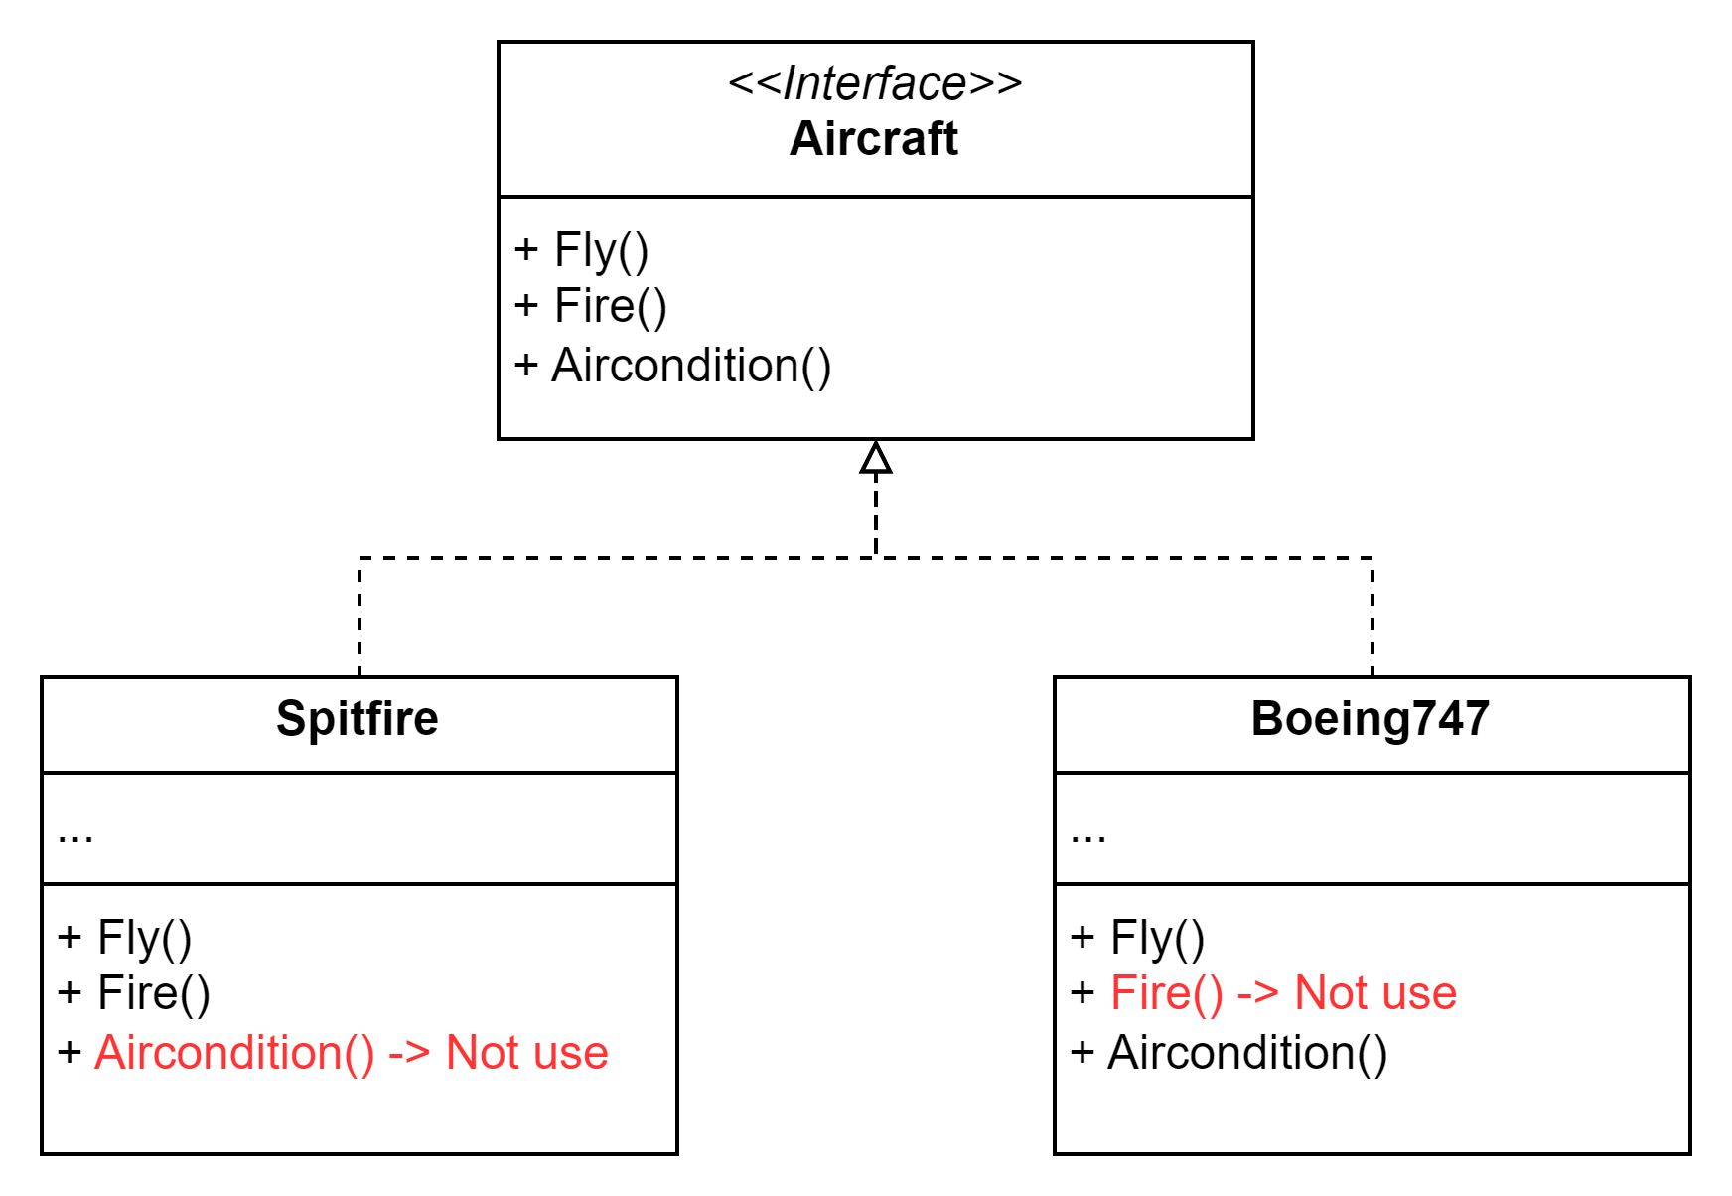
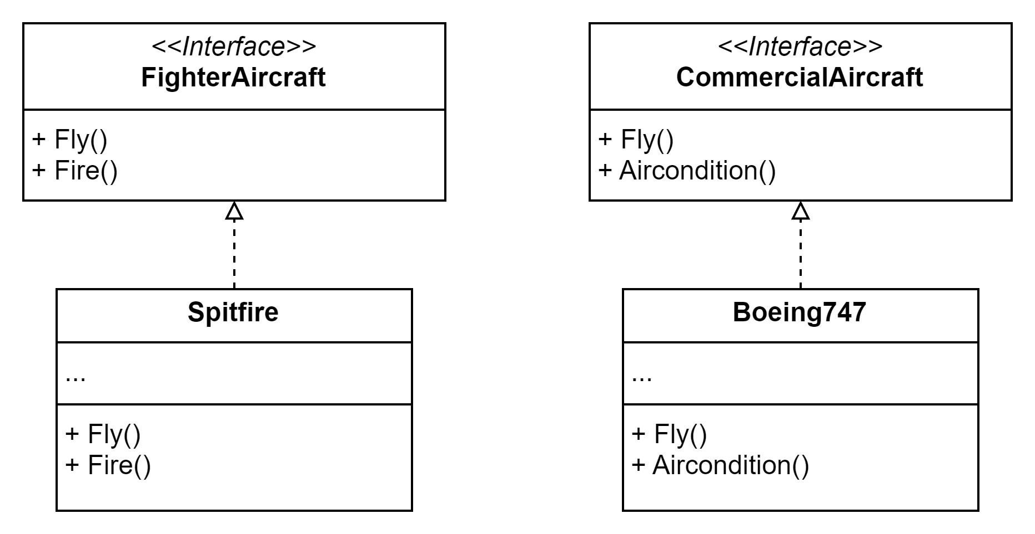
I — Interface Segregation Principle
Clients shouldn’t be forced to depend on methods they do not use.

Slide 22
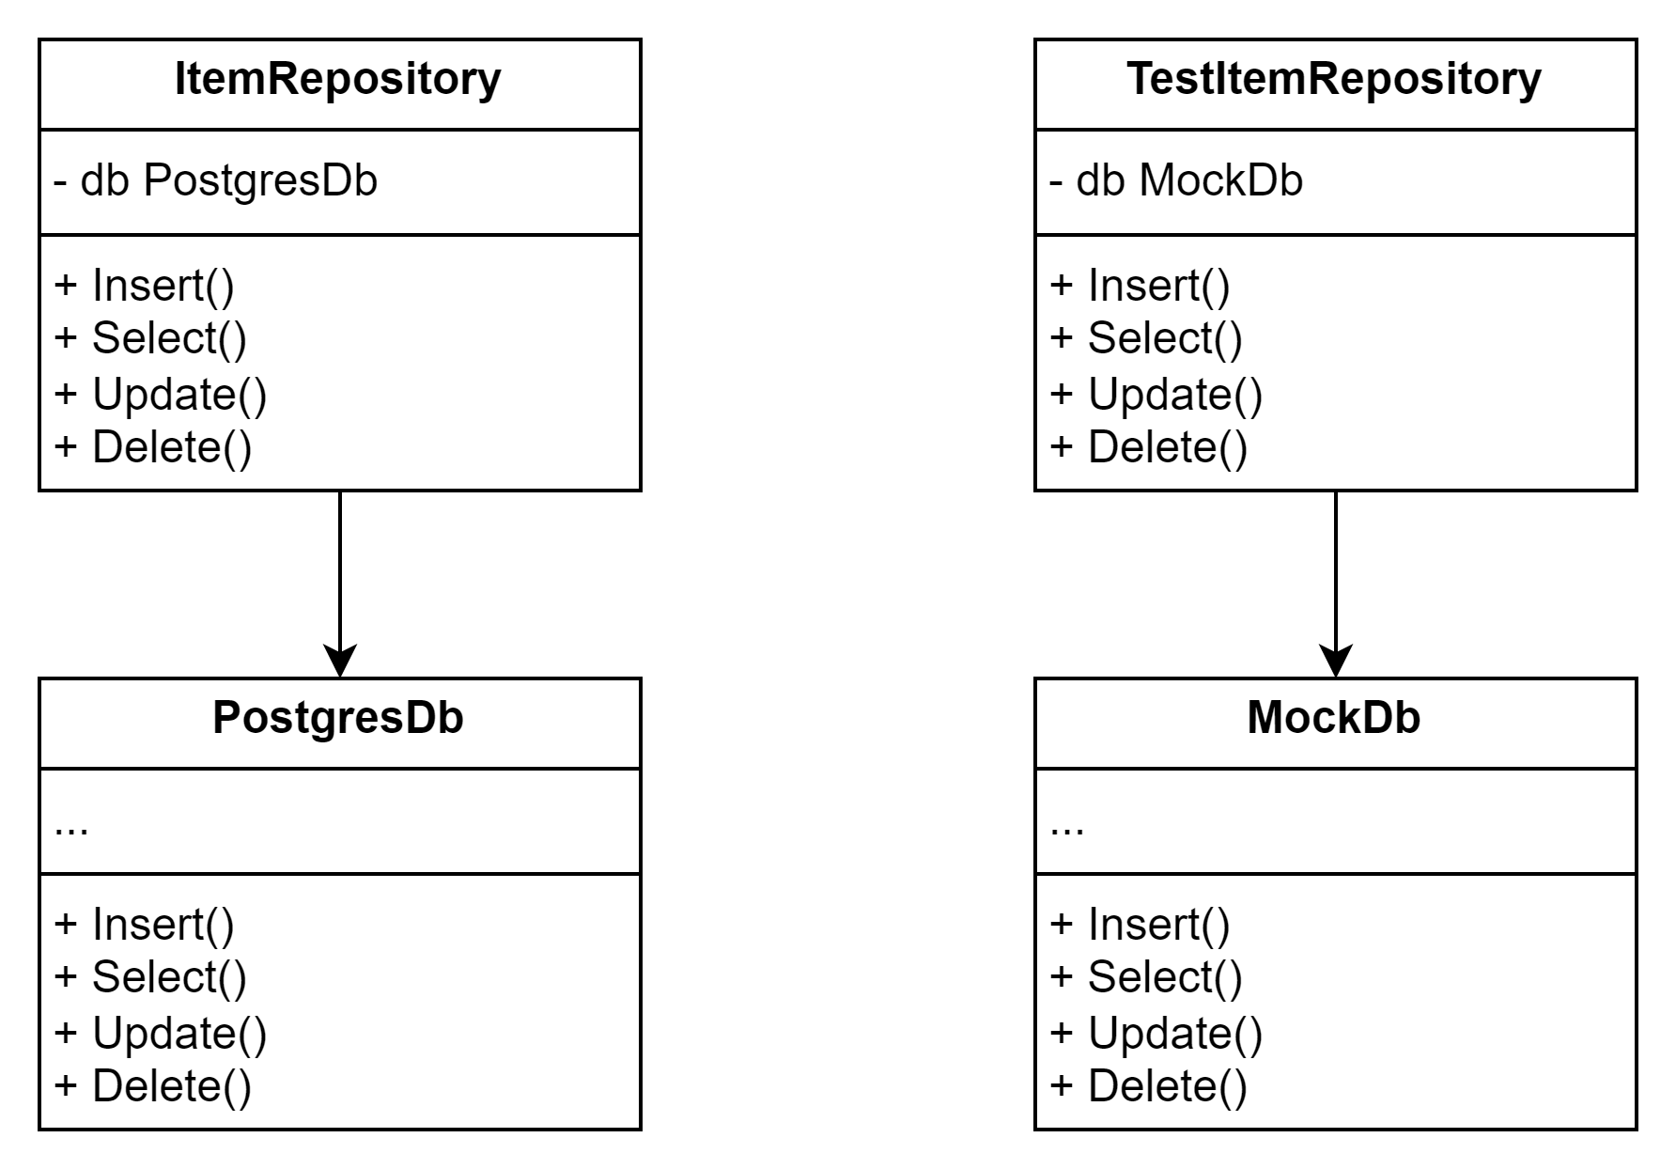
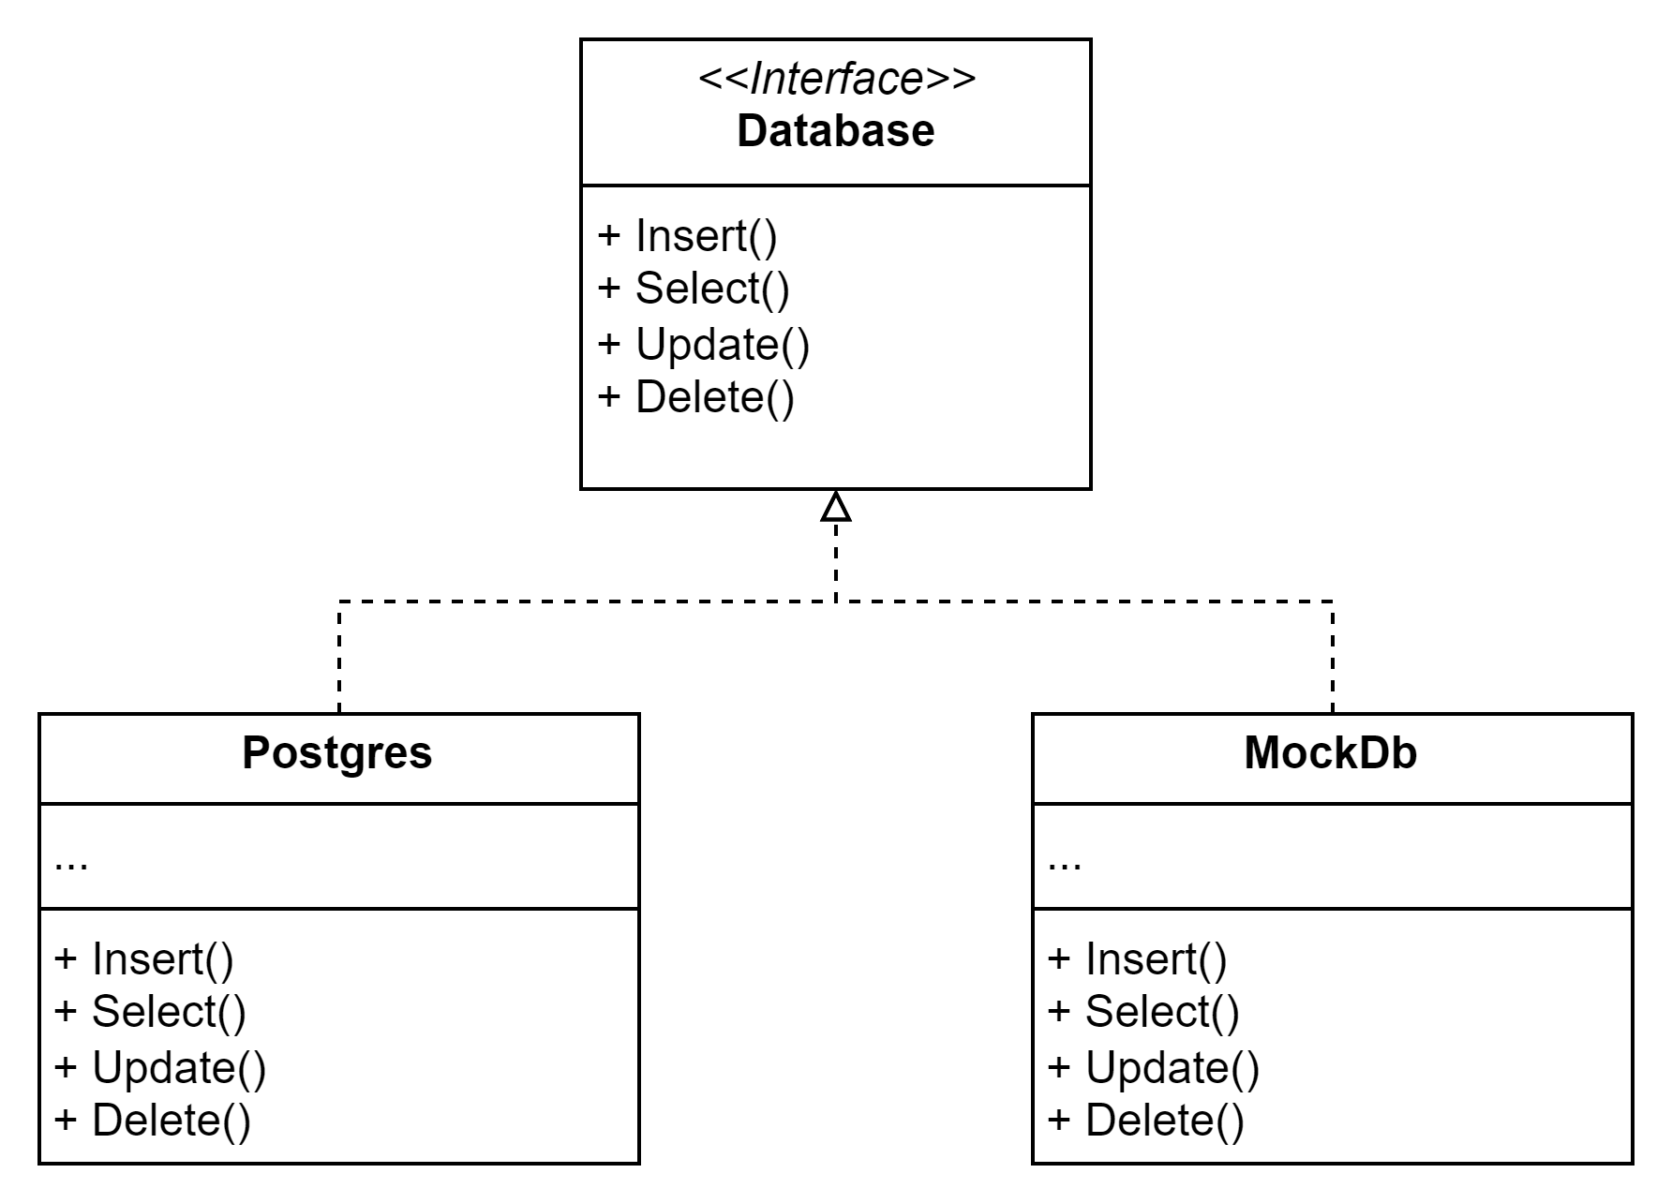
D - Dependency Inversion Principle
High-level classes shouldn’t depend on low-level classes. Both should depend on abstractions. Abstractions shouldn’t depend on details. Details should depend on
abstractions.

